Slide 1

Capstone Project-3
Mobile Price Range Prediction
Supervised Machine Learning (Classification)
By
Manas Nayan Mukherjee and Kunal Kodarlikar

Slide 2

 Classification In Machine Learning 
What is classification in supervised machine learning?
In machine learning, classification is a supervised learning concept which basically categorizes a set of data into classes. The most common classification problems are – speech recognition, face detection, handwriting recognition, document classification, etc.
Why classification in machine learning is required?
A common job of machine learning algorithms is to recognize objects and being able to separate them into categories. This process is called classification, and it helps us to segregate vast quantities of data into discrete values, i.e. :distinct, like 0/1, True/False, or a pre-defined output label class.

Slide 3

 Problem Statement 
Mobile phones have become a necessity for every individual nowadays. People want more features and best specifications in a phone and that too at cheaper prices.
Mobile phones come in all sorts of prices, features, specifications and all. Price estimation and prediction is an important part of consumer strategy. Deciding on the correct price of a product is very important for the market success of a product. A new product that has to be launched must have the correct price so that consumers find it appropriate to buy the product.
In the competitive mobile phone market companies want to understand sales data of mobile phones and factors which drive the prices. The objective is to find out some relation between features of a mobile phone (e.g.:- RAM, Internal Memory, etc) and its selling price. In this problem, we do not have to predict the actual price but a price range indicating how high the price is.
The main objective of this project is to build a model which will classify the price range of mobile phones based on the specifications of mobile phones.

Slide 4
 Work flow Segregation 
Data description
Data wrangling
Exploratory data analysis (EDA)
Conclusion
Model selection and evaluation

Slide 5
 Data Description 
Total Rows= 2000
Total features=21
Px_height and Px_width - Pixel Resolution Height and width.
Ram - Random Access Memory in Mega Bytes.
Sc_h and Sc_w - Screen Height and width of mobile in cm.
Talk_time - longest time that a single battery charge will last when you are.
Battery_power - Total energy a battery can store in one time measured in mAh.
Blue - Has bluetooth or not.
Clock_speed - speed at which microprocessor executes instructions.
Dual_sim - Has dual SIM support or not.
Fc - Front Camera mega pixels.
Four_g - Has 4G or not.
Int_memory - Internal Memory in Gigabytes.
M_dep - Mobile Depth in cm.
Mobile_wt - Weight of mobile phone.
N_cores - Number of cores of processor.
Pc - Primary Camera mega pixels.
Three_g - Has 3G or not.
Touch_screen - Has touch screen or not.
Wifi - Has wifi or not.
Price_range - This is the target variable with value of 0(low cost),1(medium cost),2(high cost) and3(very high cost).

Slide 6
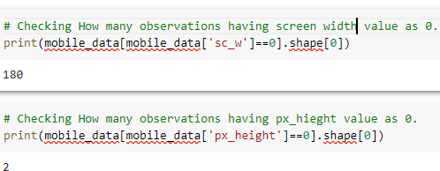

 Data Wrangling 
Missing values are imputed using the K-Nearest Neighbors approach where a Euclidean distance is used to find the nearest neighbors.

Slide 7
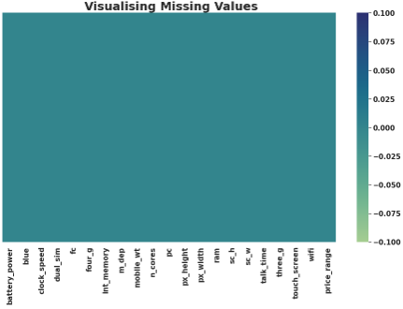


 Data Wrangling 

Slide 8
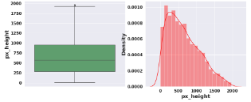
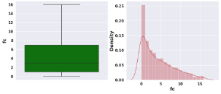
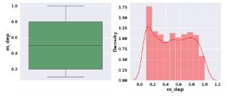
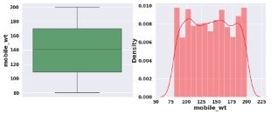
 Data Wrangling 

Slide 9
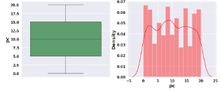
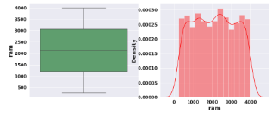
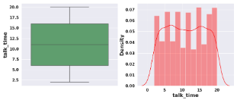
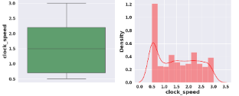
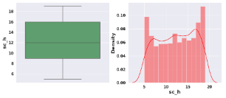
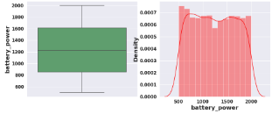
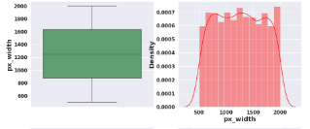
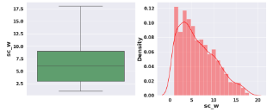
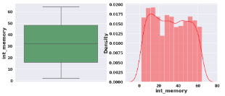
 Data Wrangling 

Slide 10
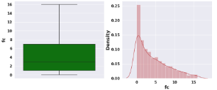
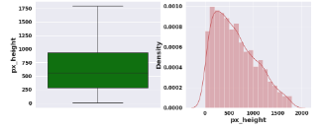
 Data Wrangling 
After removal of outliers

Slide 11
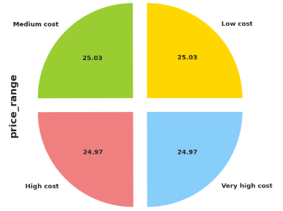
 Exploratory Data Analysis (EDA) 
Univariate Analysis
Our target variable has equal number of observations in each category.
Target variable is equally distributed and we don't have imbalanced target variable.
Accuracy score will be the best evalaution metric for us to select the model.
Thus we don't have to worry about data imbalance and there is no need of oversampling or undersampling.

Slide 12
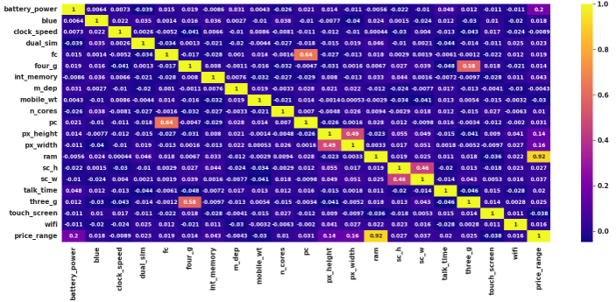
 Exploratory Data Analysis (EDA) 
Observations
Bivariate and Univariate Analysis
Primary camera i.e pc and front camera fc are positively correlated,
Sc_h and sc_w are positively correlated,
RAM has strong positive correlation with the Price range and we know that Mobiles with high RAM are very costly. Thus RAM increases price range also increase.
Battery power also has positive correlation with the price range. Generally mobiles having high prices comes with good battery power.
Also px_height and px_width (Pixel Resolution Height and width) are positively correlated. Generally High price range mobiles have good resolutions.
Four_g and Three_g are highly positvely correlated. Nowdays most of the smart mobiles has both type of options. This could be the reason that they are correlated.

Slide 13
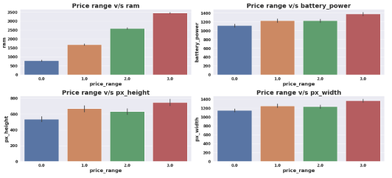
 Exploratory Data Analysis (EDA) 
Bivariate and Univariate Analysis
Observations
Mobiles having RAM more than 3000MB falls under Very high cost category.As RAM increases price range also increases.
Mobiles having RAM less than 1000 MB falls under low cost category.
Mobiles with battery power more than 1300 mAh has very high cost. And Mobiles with battery power between 1200 and 1300 mAH falls under medium and high cost category.
Mobiles with more than 700 pixel height and width more than 1300 has very high cost.

Slide 14
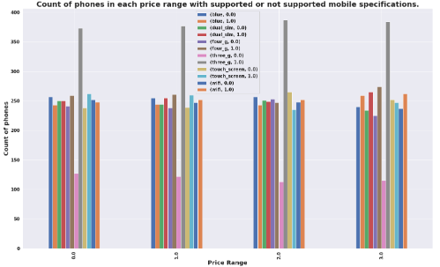
 Exploratory Data Analysis (EDA) 
Bivariate and Univariate Analysis
Observations
Each price range category has equal number of mobiles phones having both supporting and non supporting specifications.

Slide 15
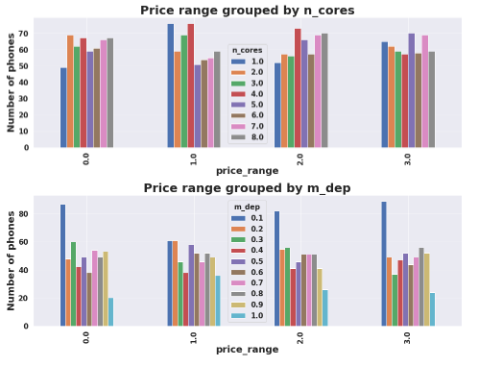
 Exploratory Data Analysis (EDA) 
Bivariate and Univariate Analysis
Observations
There are very few mobiles in price range 0 and 1 with lesser no of cores.
Most of the mobiles in price range 2 and 3 are with high no of cores.
Number of phones with less thickness is high and count of phones with high thickness is low

Slide 16
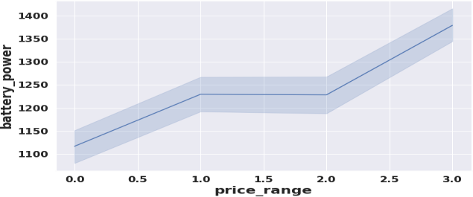
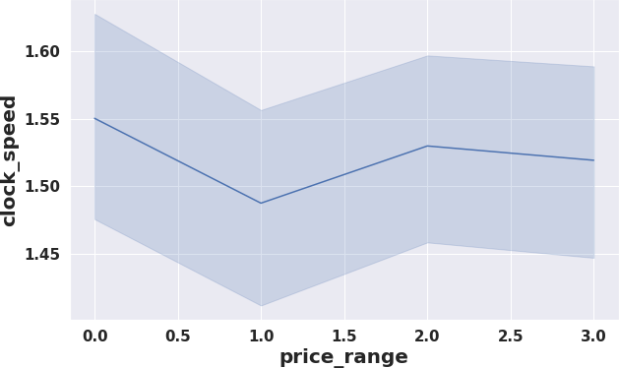
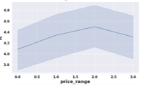
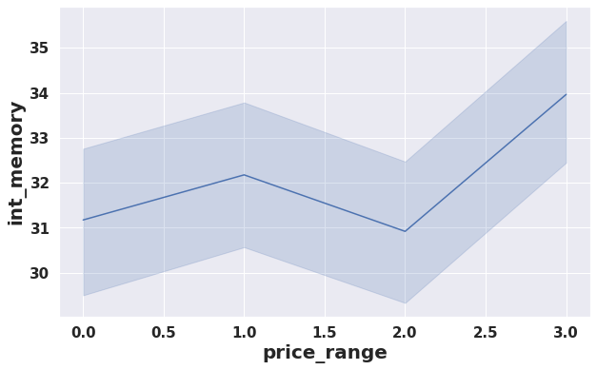
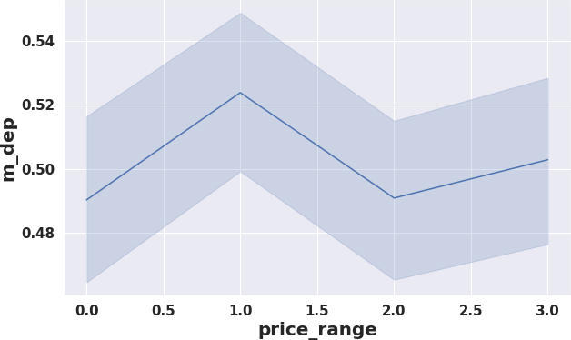
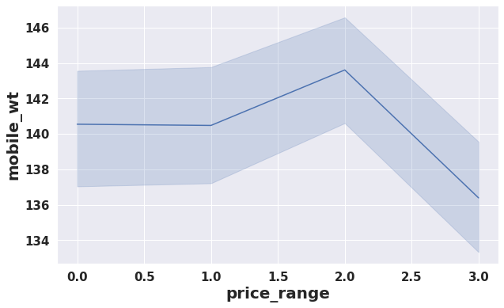
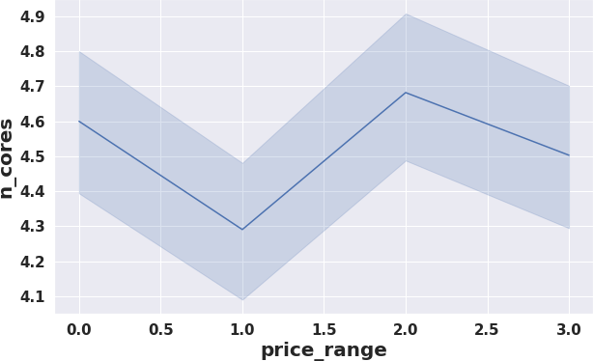
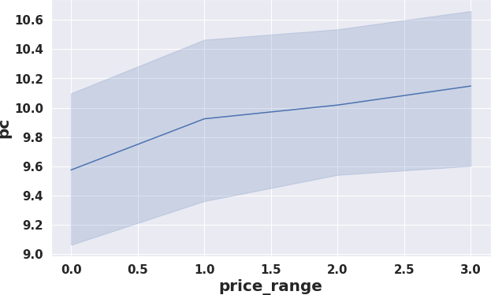
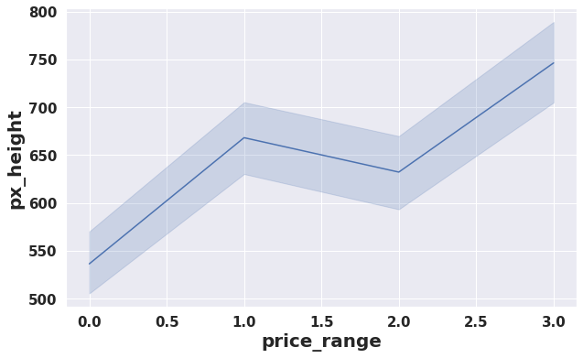
 Exploratory Data Analysis (EDA) 
Bivariate and Univariate Analysis
Different trends of price range v/s other features

Slide 17
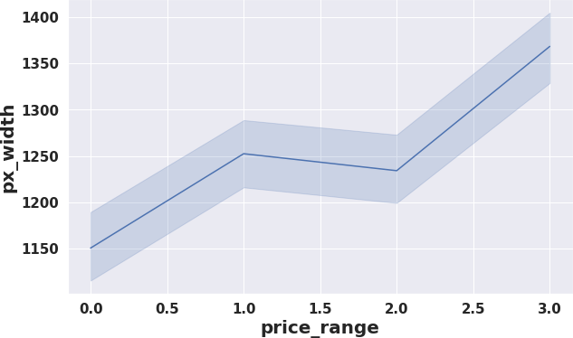
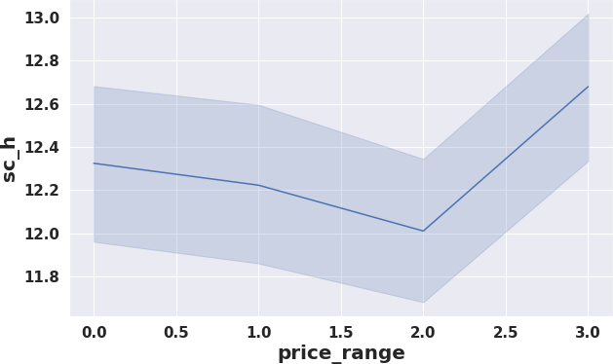
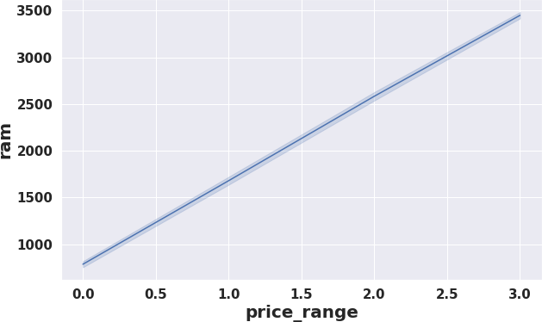
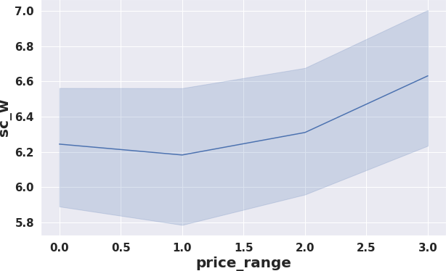
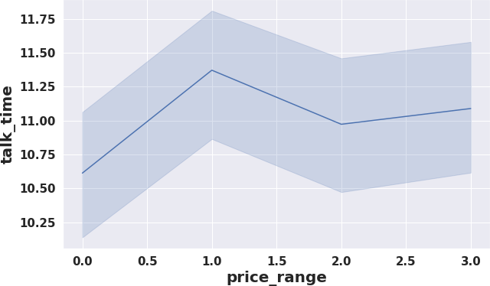
Exploratory Data Analysis (EDA)
Bivariate and Univariate Analysis
Different trends of price range v/s other features

Slide 18
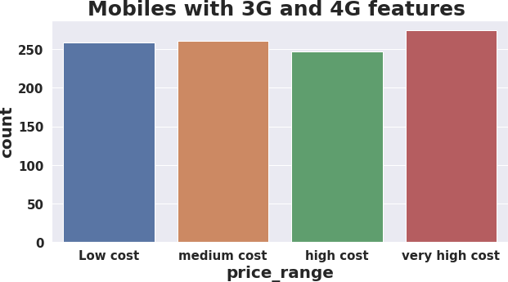
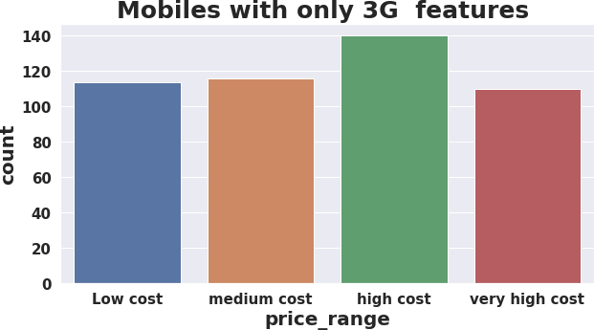
 Exploratory Data Analysis (EDA) 
Bivariate and Univariate Analysis
Observations
Count of mobiles with 3G and 4G is high in very high cost category.
Count of mobiles with only 3G feature is high in high cost category.

Slide 19

 Model Selection and Evaluation 
Before building a models we performed the train test split. We kept 25% of the data for test and remaining 75% of the data for training the model.
We compared 6 algorithms and evaluated them based on the overall accuracy score and the recall of the individual classes.
Accuracy is the ratio of the total number of correct predictions and the total number of predictions.
The recall is the measure of our model correctly identifying True Positives.
1. Decision Tree.
2. Random Forest classifier.
3. Gradient Boosting Classifier
4. K-nearest Neighbor classifier
5. XG Boost Classifier
6. Support Vector Machine(SVM)

Slide 20
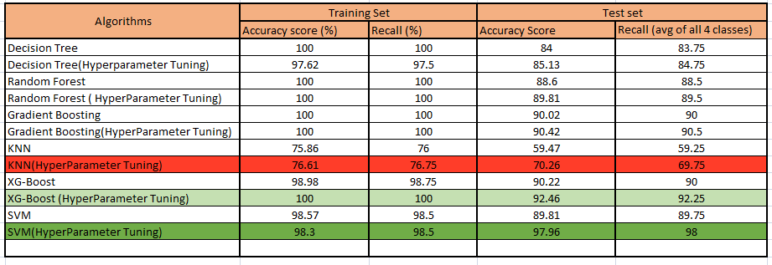
 Evaluation of Models 
1. Best model came out to be SVM after hyper-parameter tuning.
2. XG boost (Hyper-parameter Tuned) can be considered as the second most good model.
3. KNN performed very worst.

Slide 21
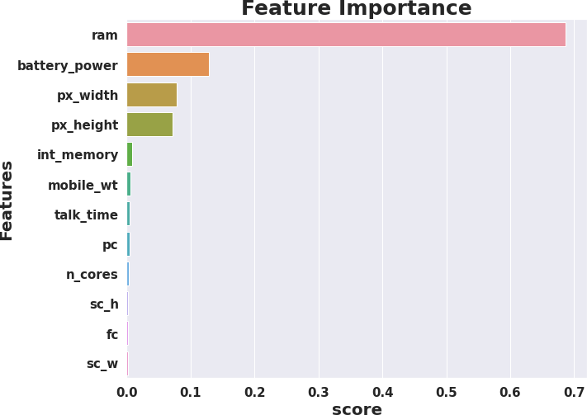
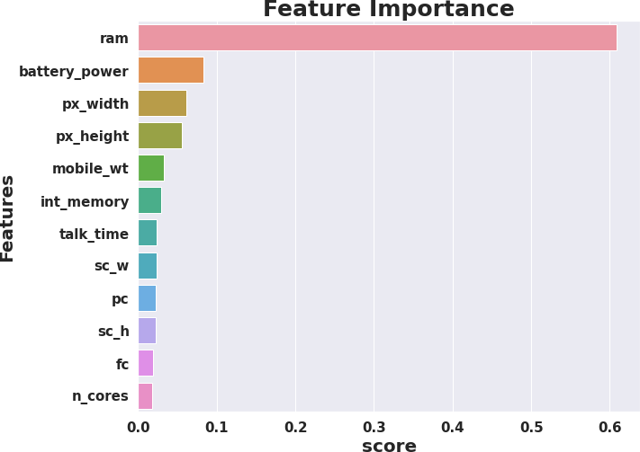
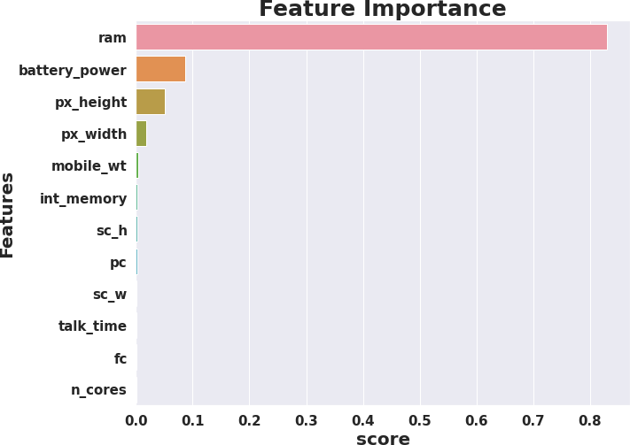
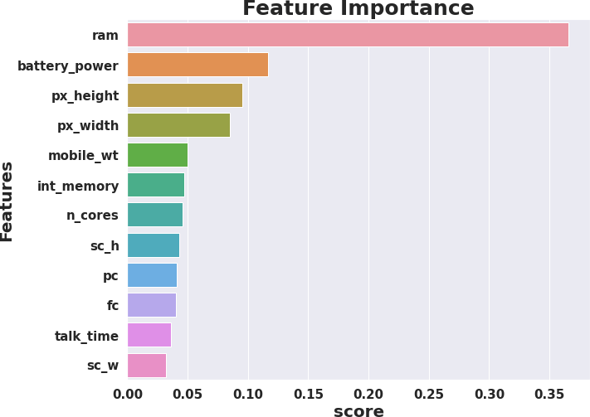
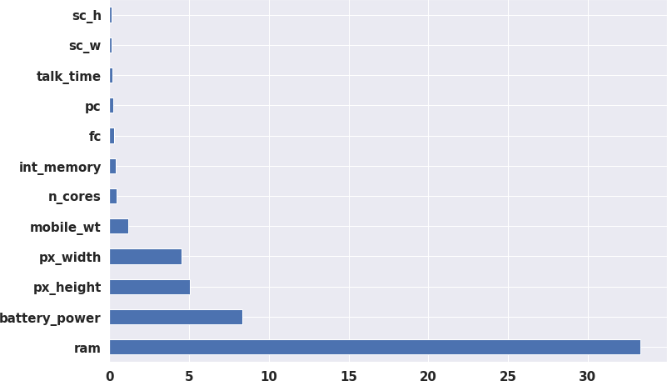
 Feature Importance 
Decision Tree
Random Forest
Gradient Boost
XG boost
SVM
RAM, Battery Power, Pixel height and weight contributed the most in predicting the price range.

Slide 22
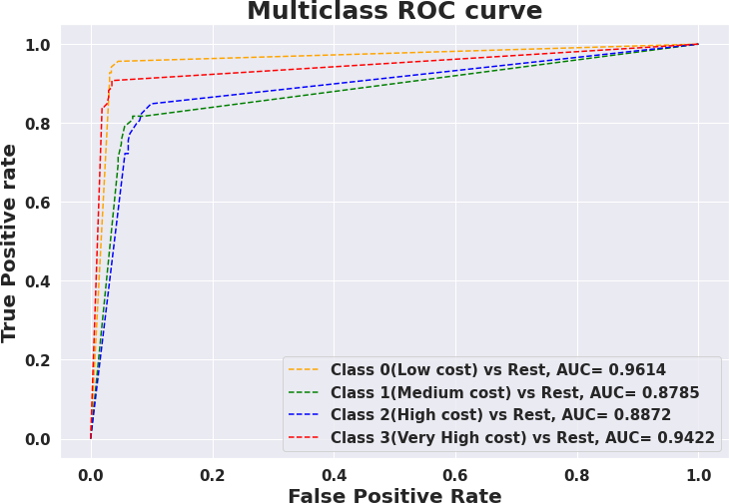
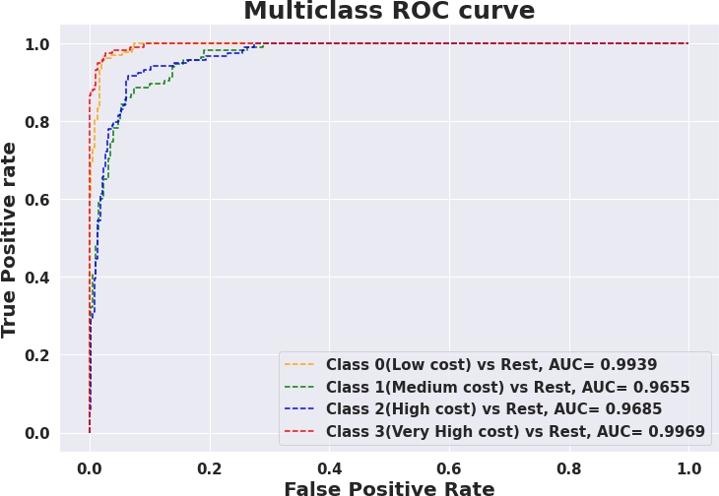
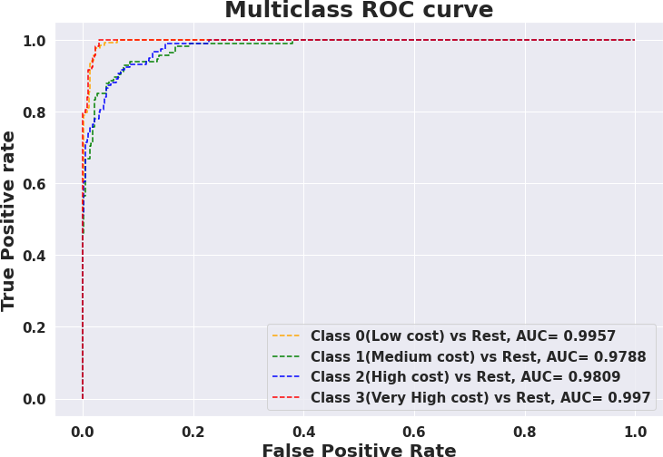

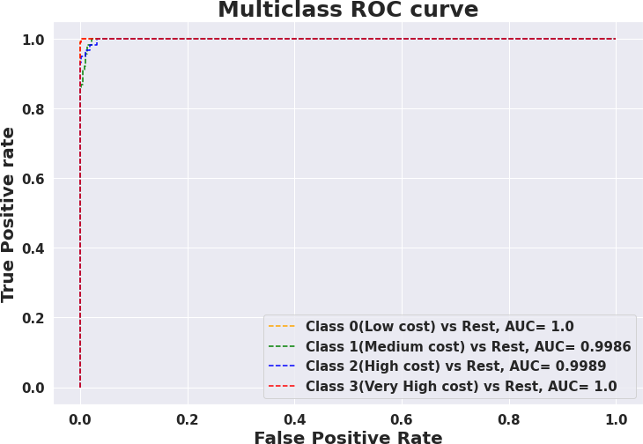
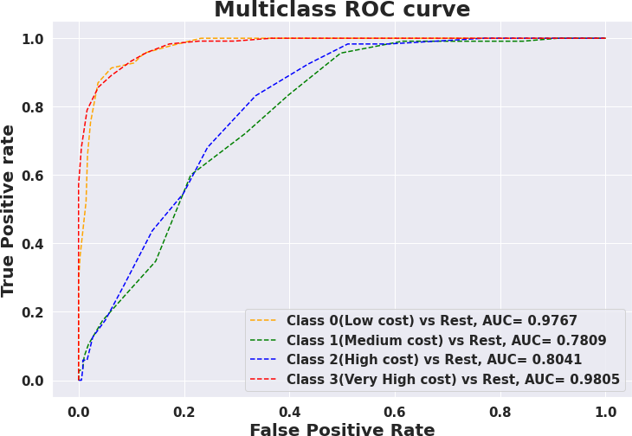
AUC ROC curves
Decision Tree
Random Forest
Gradient Boost
XG boost
SVM
KNN

Slide 23

 Conclusion 
We Started with Data understanding, data wrangling, basic EDA where we found the relationships, trends between price range and other independent variables.
We selected the best features for predictive modeling by using K best feature selection method using Chi square statistic.
Implemented various classification algorithms, out of which the SVM(Support vector machine) algorithm gave the best performance after hyper-parameter tuning with 98.3% train accuracy and 97 % test accuracy.
XG boost is the second best good model which gave good performance after hyper-parameter tuning with 100% train accuracy and 92.25% test accuracy score.
KNN gave very worst model performance.
We checked for the feature importance's of each model. RAM, Battery Power, Px_height and px_width contributed the most while predicting the price range.

Slide 24


